Slide 1

Next-Generation Web Systems for Medical Clinics (Doctor Today)
Group 16
Yutong Chen, Anyan Zhao, Yinqian Cui, Tian Gu, Chloe Wu, Shuyao Zhang
with Professor William Knottenbelt
Mar 14, 2023

Slide 2


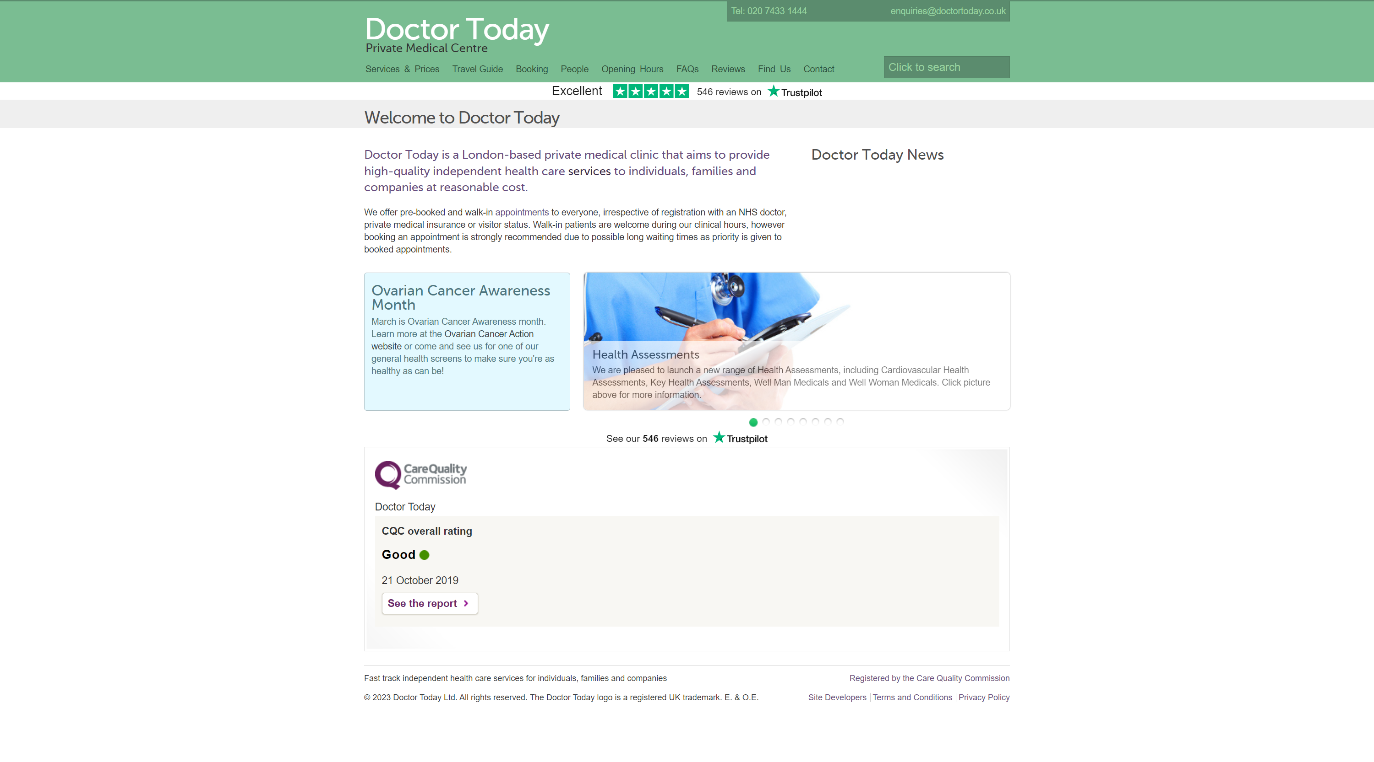
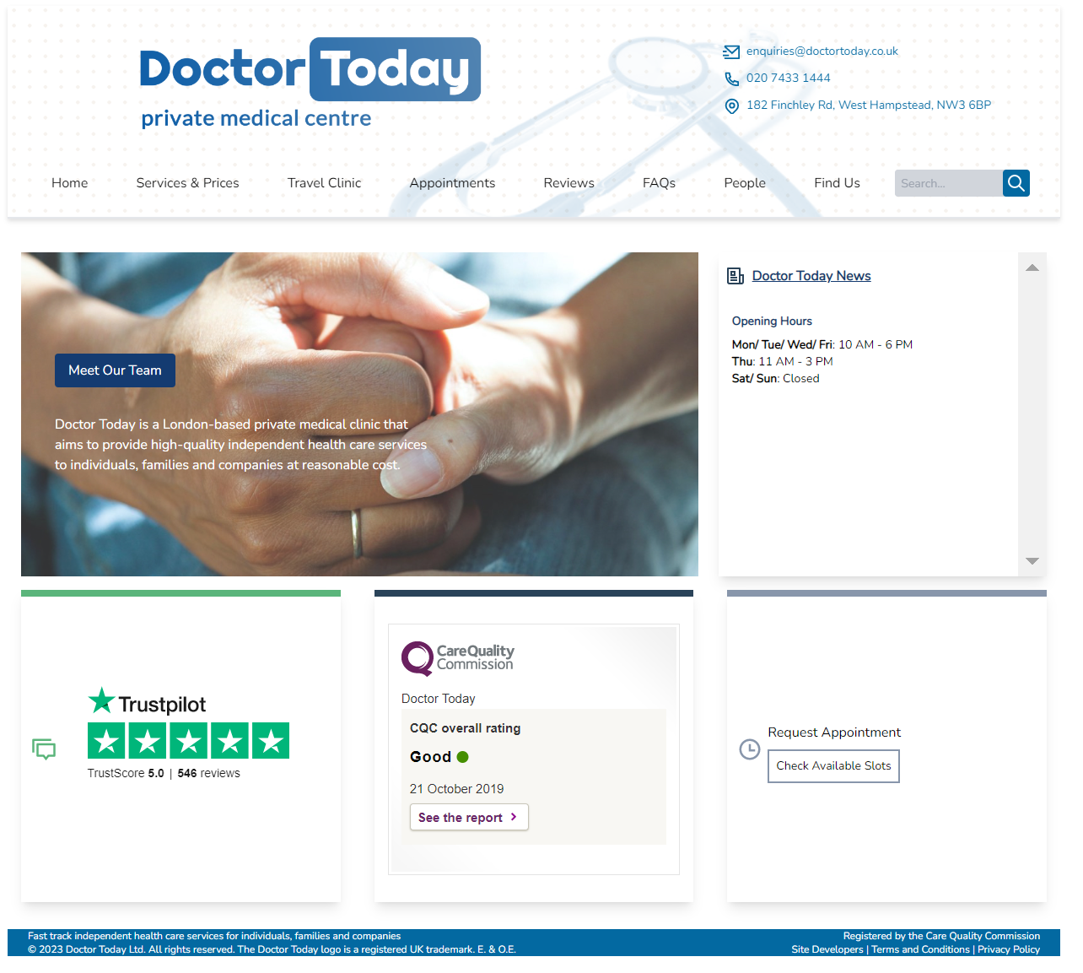


Doctor Today
A London-based private medical clinic
Before
After
Project Goals
Flexible & Customizable​
Better User Experience

Slide 3
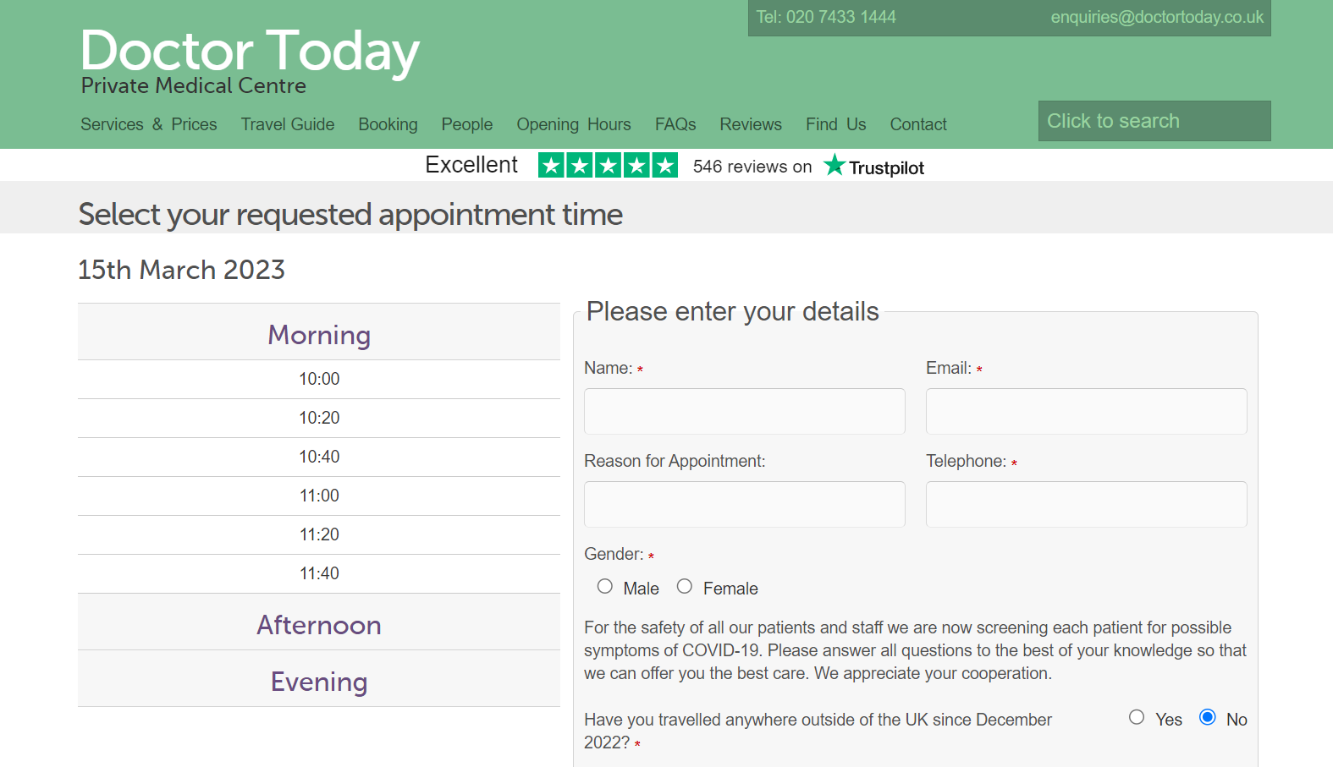

Challenges
01
Complicated process for appointment booking
Request an appointment
Wait for confirmation
Walk in

Slide 4
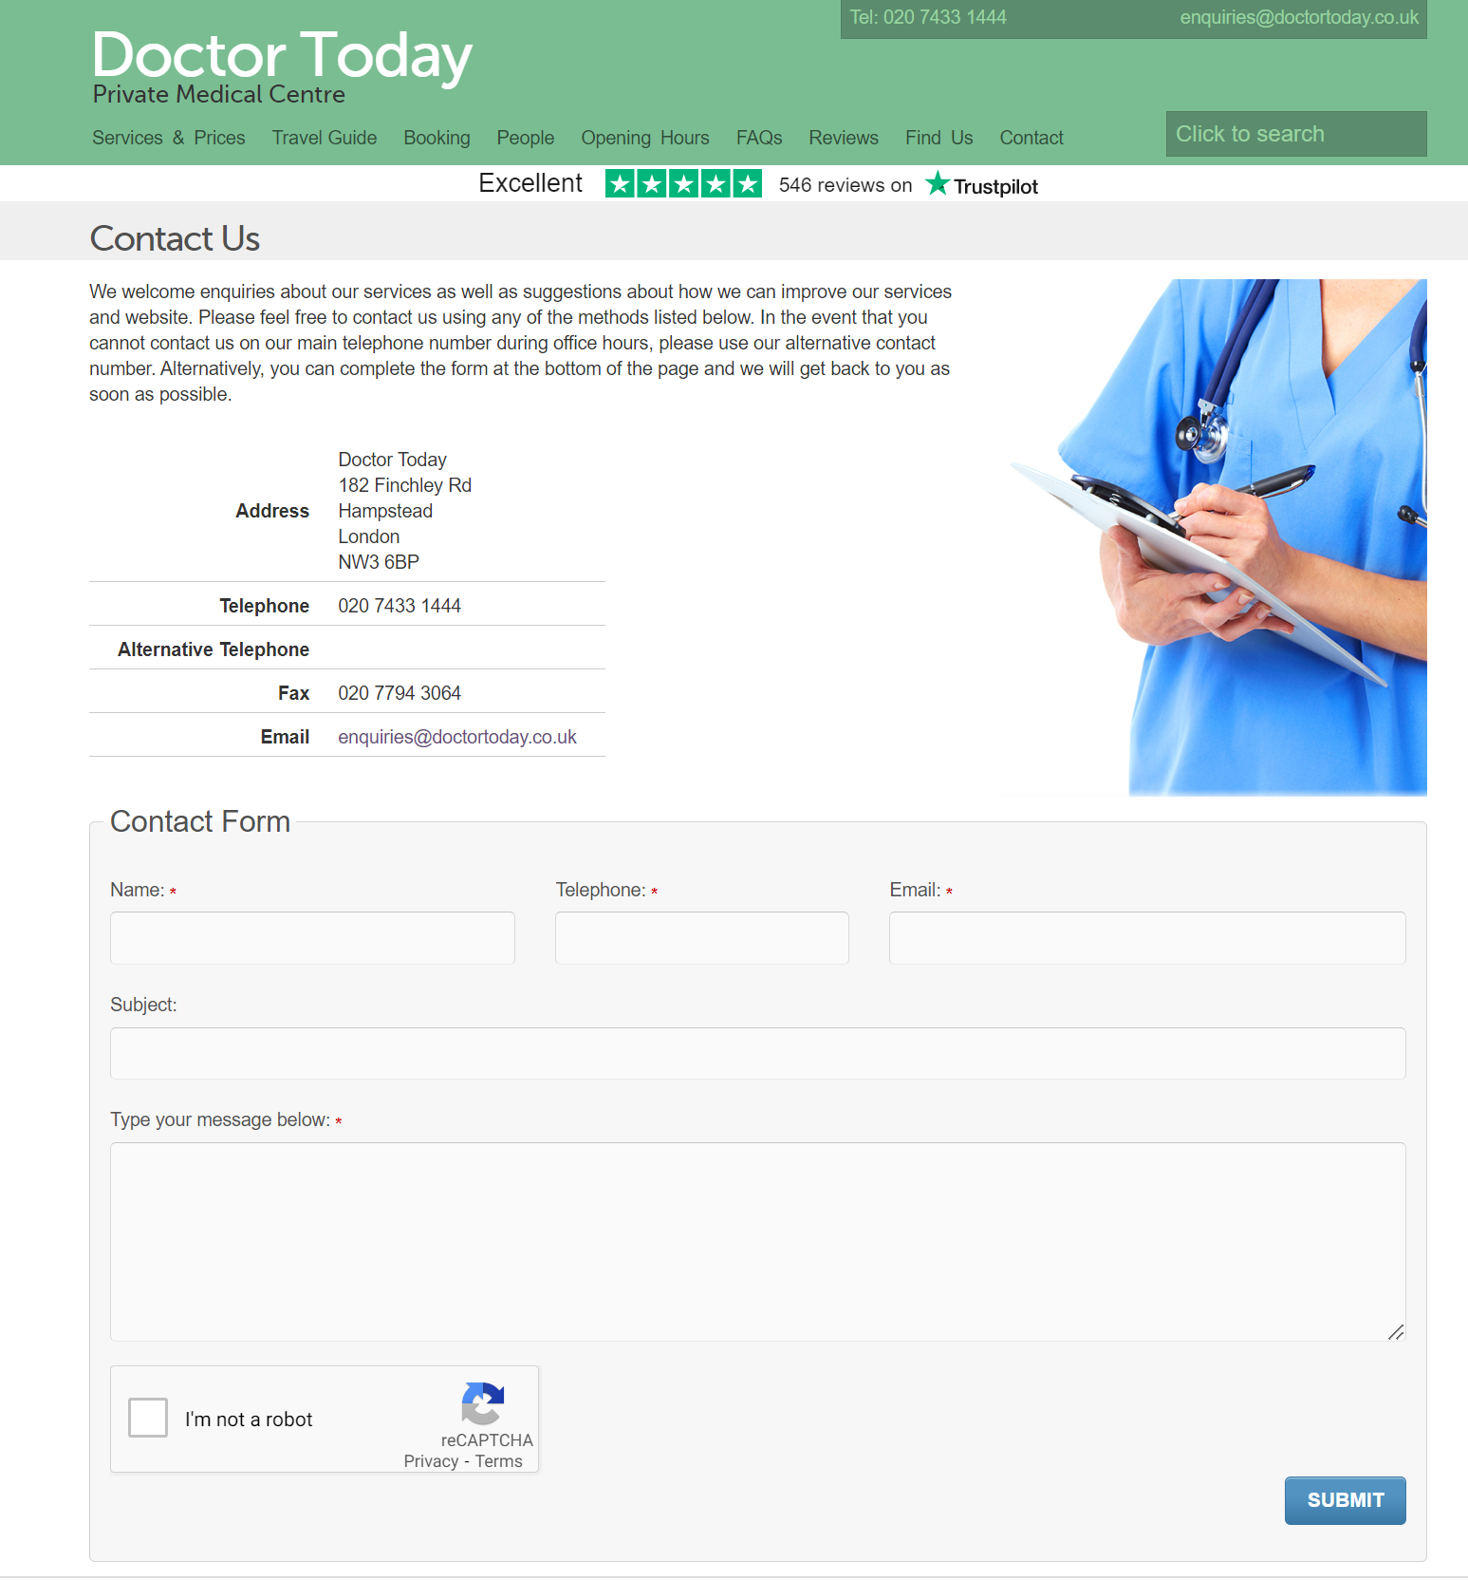
Challenges
02
Long wait time over phone / email

Slide 5
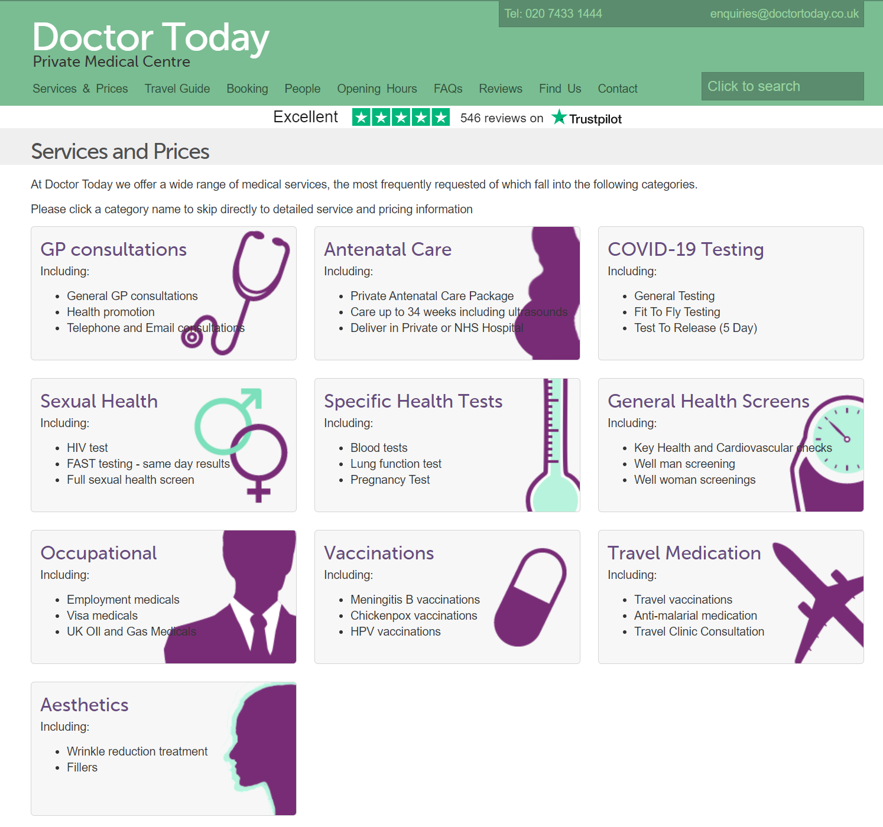
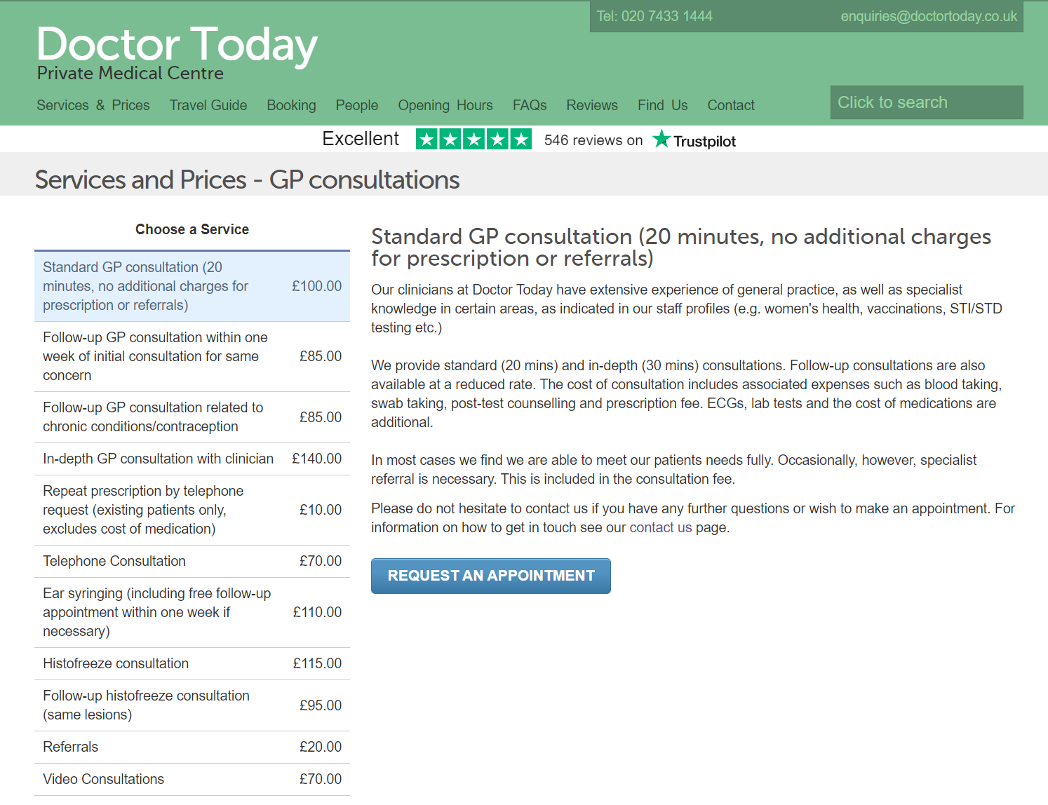

Challenges
03
Frequent updates for content needed
lab test prices
services
etc…

Slide 6
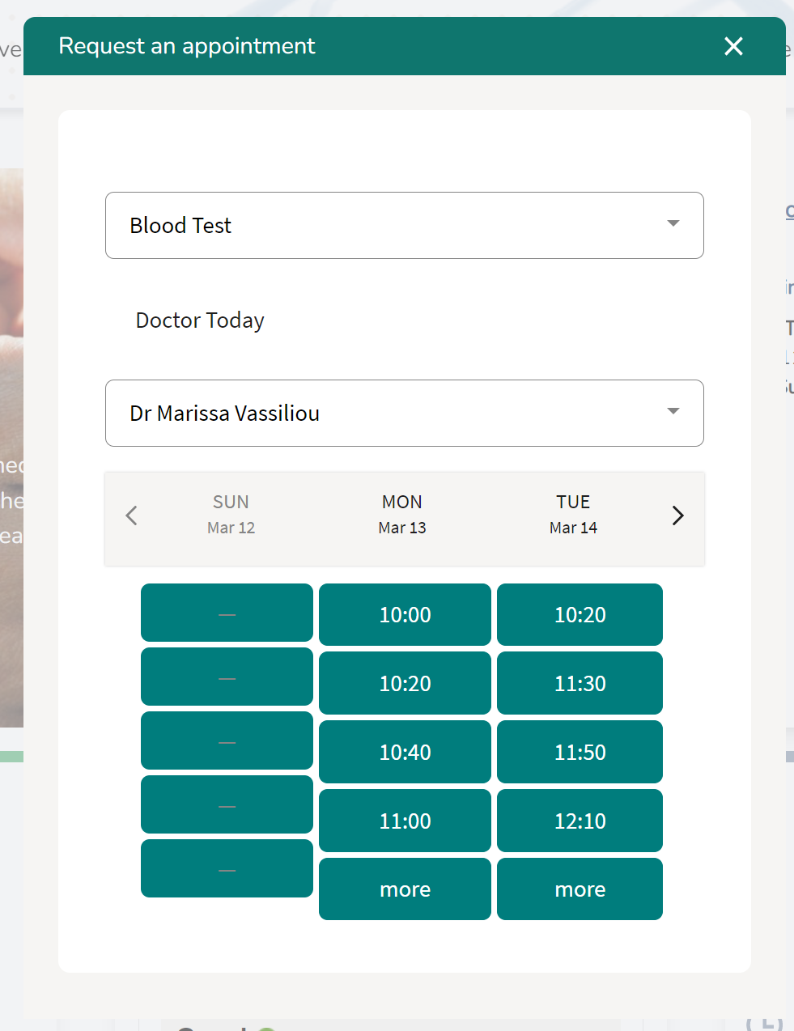
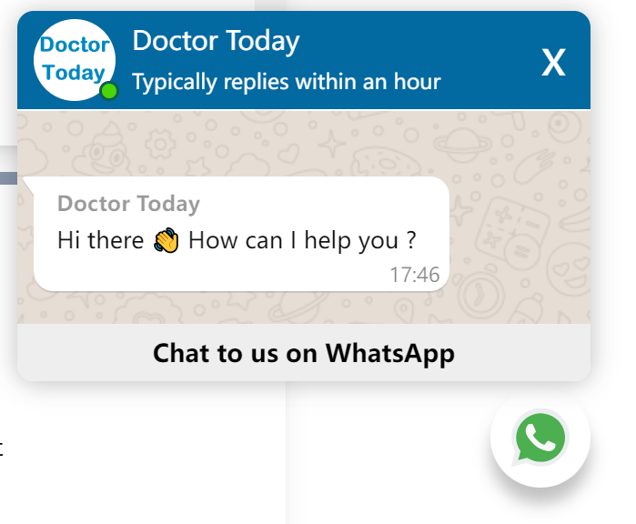


Our Solutions
Integration of
External Services
as a patient record management system, also provides real-time visibility for appointment slots
connecting patients and the clinic

Slide 7
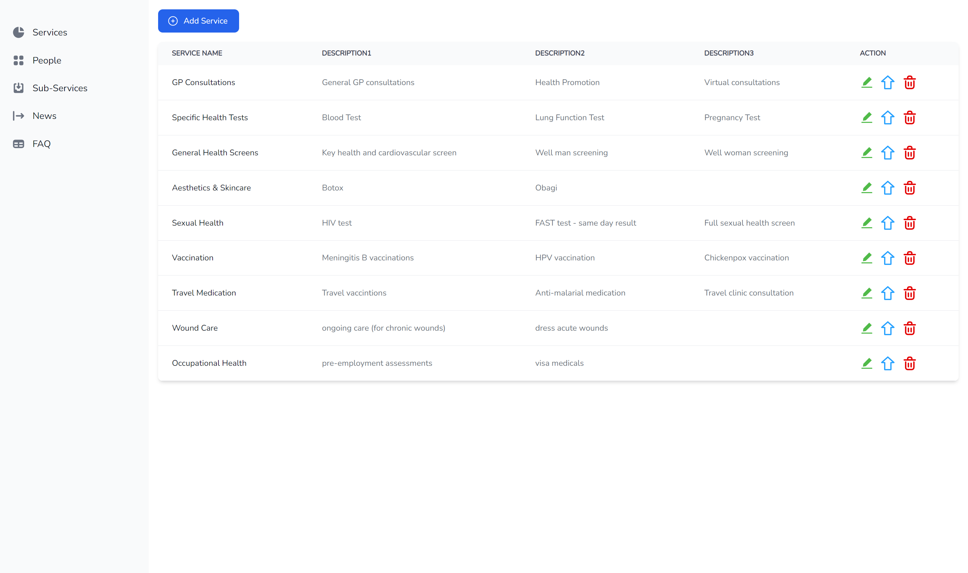
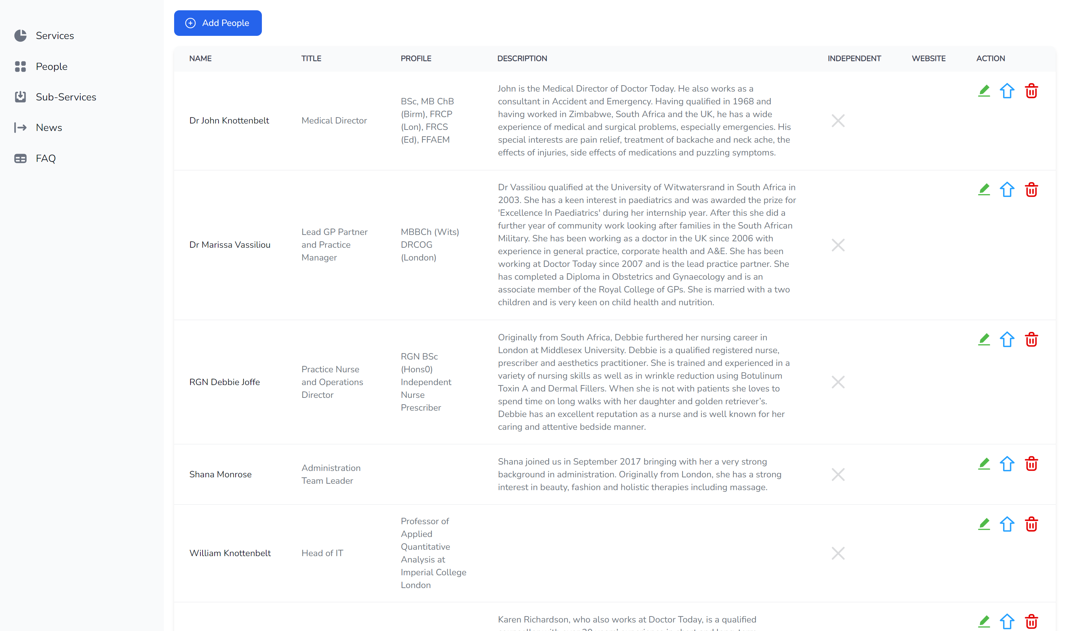
Our Solutions
Flexible & Customizable
Configurability without any technical knowledge

Slide 8
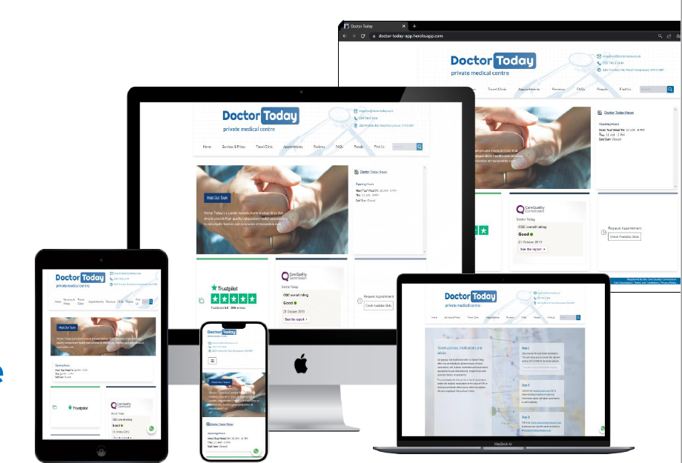
Our Solutions
Mobile First &
Responsive Web Design
Mobile phones
Tablets
Laptops
PCs
Cross-Browser Compatible
Chrome/Safari/Edge/Firefox, etc

Slide 9
Demo

Slide 10
Technical details on implementation

Slide 11





Technical details on implementation
Backend
Frontend
User API
User-side
Database
HTTP Request
Admin-side
Admin API
HTTP Request

Slide 12

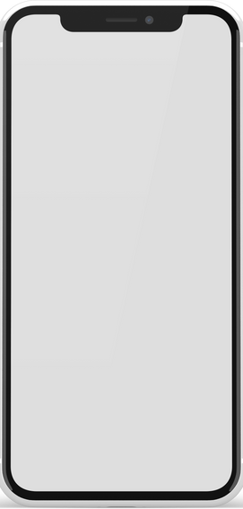




Technical details on implementation
Backend
Frontend
User API
User-side
Database
HTTP Request
Admin-side
Admin API
HTTP Request

Slide 13
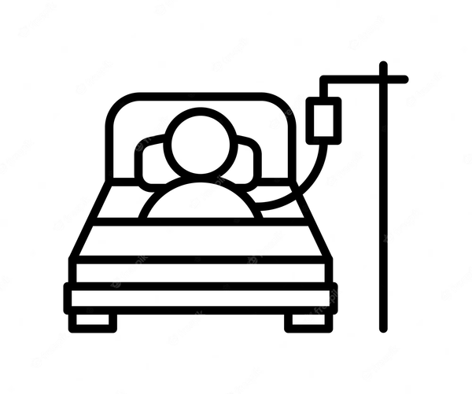


Technical details on implementation
Backend
Frontend
User API
User-side
fetch clinic information
search service
send register email
Database
HTTP Request
Website User
Admin-side
Admin API
HTTP Request
add/ delete/ edit content
manage images
manage display order
Clinic Staff

Slide 14



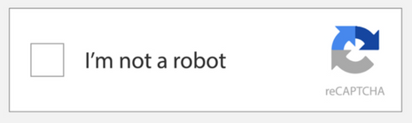
External Services Integration
Apple Maps
Backend
Frontend
User API
User-side
fetch clinic information
search service
send register email
Database
HTTP Request
Website User
Admin-side
Admin API
HTTP Request
add/ delete/ edit content
manage images
manage display order
Clinic Staff

Slide 15

External Services Integration
Apple Maps
Backend
Frontend
User API
User-side
fetch clinic information
search service
send register email
Database
HTTP Request
Website User
Admin-side
Admin API
HTTP Request
add/ delete/ edit content
manage images
manage display order
Clinic Staff

Slide 16


Evaluation
We have received praises from clinic staffs and IT consultant from Trustpilot
"Thank you for the sneak peek of the new site ;) It looks great! The new look is both refreshing and professional."
--ESTHER LAU
Associate Customer Success
Manager @ Trustpilot
The integration of different services also makes the website more user-friendly and satisfies the requirements from our client
Mobile-first design
Cross-browser compatibility
Customisable
Portable
Highly Rated​​
User-Friendly ​​
13/15 pages configurable via admin portal
easy update and maintenance without knowledge of web development
Could be easily configured for other clinics
Notes:
• For evaluation purpose, here we have included a quote from Trustpilot and they seem to love the refreshed look of the website. The clinic staffs also would like to use this new site ASAP because it solves the problem that the old site is causing everyday with people having no confirmed appointment walking into the clinic for consulting, vaccines and so on.
• The integration of different services (Semble, Trustpilot, WhatsApp, Recaptcha) also makes the website more user-friendly. For example, now the booking can be done through WhatsApp so the nurse could worry less about not being able to pick up the phone booking while taking care of the patients. They can respond when they are free on WhatsApp.
• We have also designed and developed this site with mobile-first and multi-browser compatibility in mind for a smooth customer experience. Now it works quite nicely not only on a desktop or a laptop, but also on phones and tablets, and it's also compatible with several major browsers such as Chrome/Safari/Edge/Firefox.
• One of the strengths of our product is that it is fully flexible and customizable with 13 out of 15 pages can be configured via the dashboard we built inside the admin portal, so staffs from the clinic can easily update and maintain their website, and that requires no prior IT knowledge or any support from us.
• Another strength is that for similar use case or perhaps Doctor Today wants to open a new branch at South Kensington, we do not need to build from scratch a new website, but the task would only cost us minimal efforts to modify the content based the current codebase. In fact, any clinic who prefers our design or have similar demands on the functionalities can easily set up their own customized websites using our web system since we have created modular and reusable components so that we can adapt them to fit specific requirements for similar medical practices.
• That sums up our presentation, now we can take up questions.
­­

Slide 17

Q & A

